Slide 1













TIME SERIES FORECASTING: Week 2

Slide 2




DSBA CURRICULUM DESIGN
CORE COURSES
DOMAIN APPLICATIONS
FOUNDATIONS
Data Science Using Python
Advanced Statistics
Finance and Risk Analytics
Statistical Methods for Decision Making
Data Mining
Predictive Modelling
Marketing and Retail Analytics
Machine Learning Data Visualization
SQL
Time Series Forecasting (Week-2/4)

Slide 3


LEARNING OBJECTIVE OF THIS COURSE
Time Series Analysis
Time Series Forecasting –
Introduction to Forecasting
ARIMA Models

Slide 4

LEARNING OBJECTIVES OF THIS SESSION
Introduction to Time Series Forecasting – Taking advantage of Trend and Seasonality to get better forecasts
Model Validation using a Train-Test Split

Slide 5











TRY ANSWERING THE FOLLOWING
A more complicated model which estimates a lot of parameters usually always performs better (i.e. gives a better accuracy or a less error) on the training data. – True or False? Discuss.
For Model Validation in a Time Series Forecasting problem, the train and test data can be randomly sampled. True or False? Discuss.

Slide 6

BROAD OVERVIEW
Time Series Forecasting equips us with a lot of tools which help us to predict the “future”.
We do need to remember one thing that the further we predict into the future, the more unreliable or error-prone our forecasts becomes.
In this session we will look at a case study, build different models on it and select the best model by looking at the accuracy score (i.e. the least error) on the test data.

Slide 7
Concept of Confidence Intervals:*
When we predict certain time points into the future, we might need to have a concept of Confidence Bands/Intervals for our predictions. This gives us range of values in which our predictions will be lying in the future or for the future time stamps.
We need to answer the questions of, “How confident are we of our predictions?”
Note: A 95% confidence interval tells us that we are 95% confident that our predictions are going to lie within a certain range
*The concept of confidence interval will be covered in the video lectures in the upcoming weeks

Slide 8

Industry Application – Predicting National Income and Government Spending
Time Series Forecasting procedures are often used in Public Policy making. The government has to have to an idea about the national income and the corresponding tax collections. Certain regulations can be changed or altered keeping in mind the upcoming future forecasts. Various economic decisions are taken based on these future predictions. When a model is being fitted for such an application, usually white-box models are preferred.
Video Lecture on using Analytics in Public Policy making.

Slide 9

CASE STUDY- Predicting the Monthly Sales of a Particular Store.
In this particular case study, we are going to look at some of the descriptive measures of statistics to understand the data a bit better. Then we will go ahead and split the data into training and test. After this, we will build different models on the data and choose the most optimum model.
The objective of this session is to predict the monthly sales of a particular store for some future time stamps.

Slide 10











ANY QUESTIONS

Slide 11
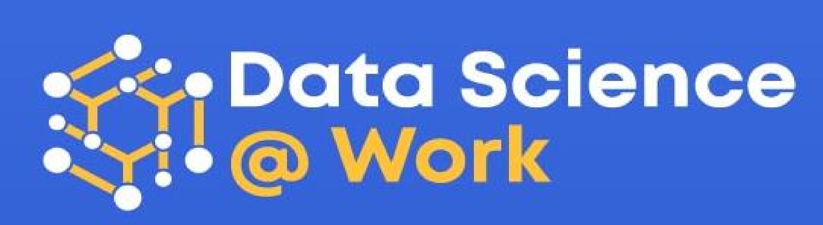

Apply Data Science at your workplace to gain some instant benefits:
Get noticed by your management with your outstanding analysis backed by data science.
Create an impact in your organization by taking up small projects/initiatives to solve critical issues using data science.
Network with members from the data science vertical of your organization and seek opportunities to contribute in small projects.
Share your success stories with us and the world to position yourself as a subject matter expert in data science.

Slide 12
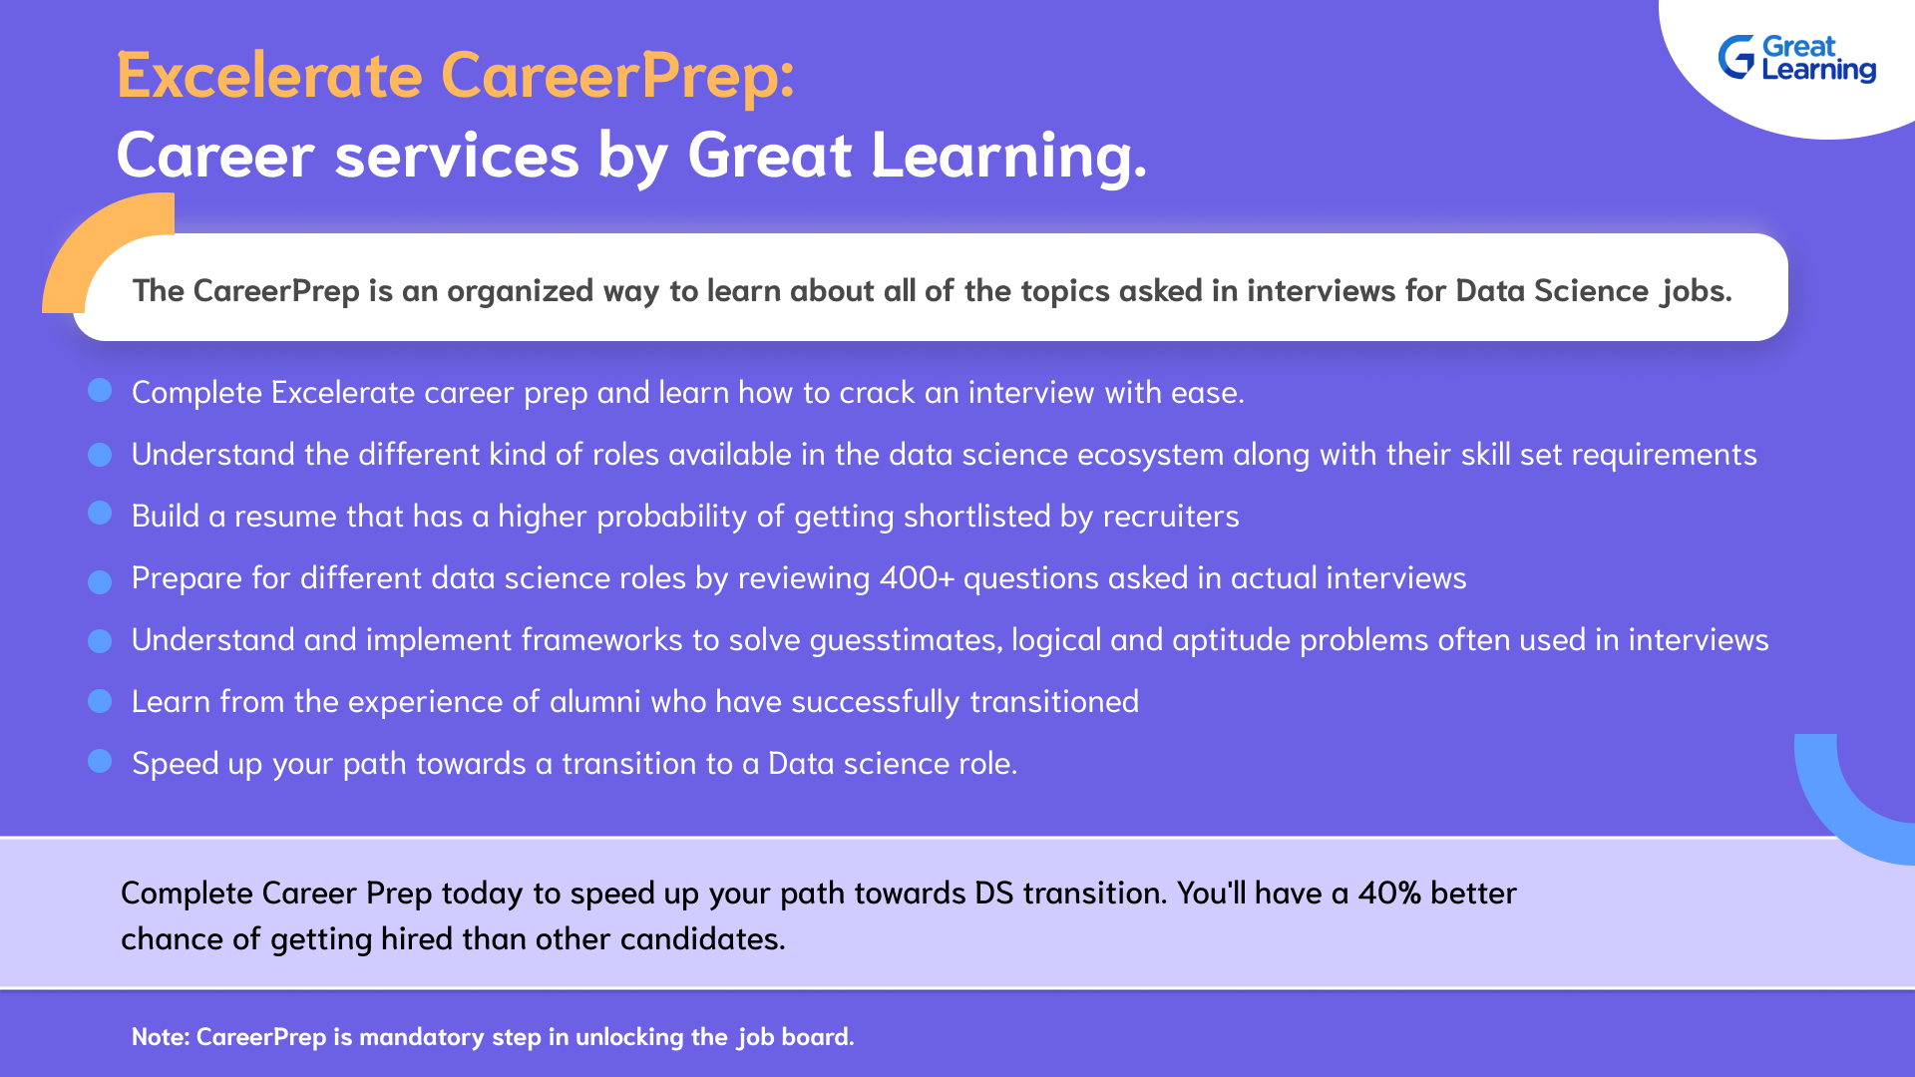

Slide 13

HAPPY LEARNING
Proprietary content. ©Great Learning. All Rights Reserved. Unauthorized use or distribution prohibited.

